Slide 1

Edge Computing and Reliable Data Transmission
CSA0714 - Slot C
Computer Networks
ASSESSMENT TOOL 3 – TECHNICAL PRESENTATION
Faculty Name:
Dr. P. Jesu Jayarin
Presented by
Devi Shree Babu (192524025)

Slide 2


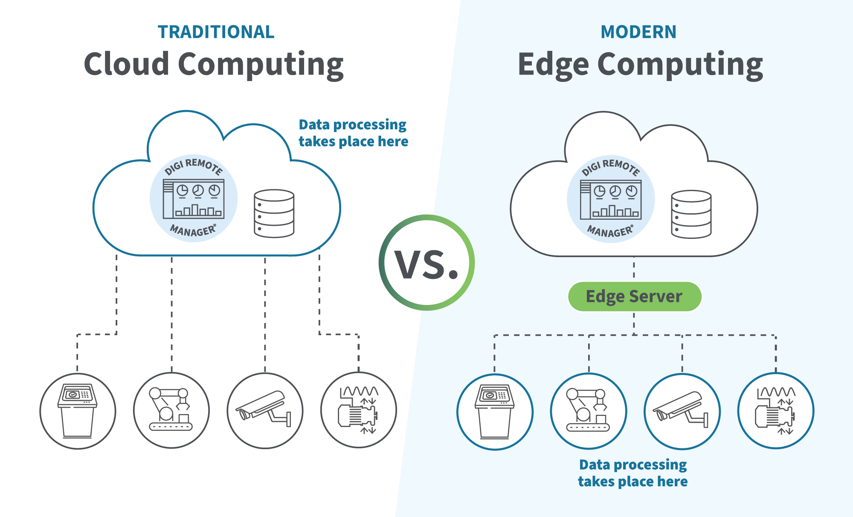
INTRODUCTION
Edge Computing processes data closer to the source instead of a centralized cloud.
Reliable Data Transmission ensures data reaches its destination accurately and without errors.
Together, they improve network speed, reliability, and efficiency.

Slide 3
Edge Computing
Edge Computing is a distributed computing model where data is processed near the source of data generation instead of sending all data to a distant cloud server
Key Features
Reduces network latency
Saves bandwidth
Enables real-time processing
Improves privacy and security
Reduces cloud workload
Advantages
Faster response time
Lower network congestion
Better Quality of Service (QoS)
Improved scalability

Slide 4
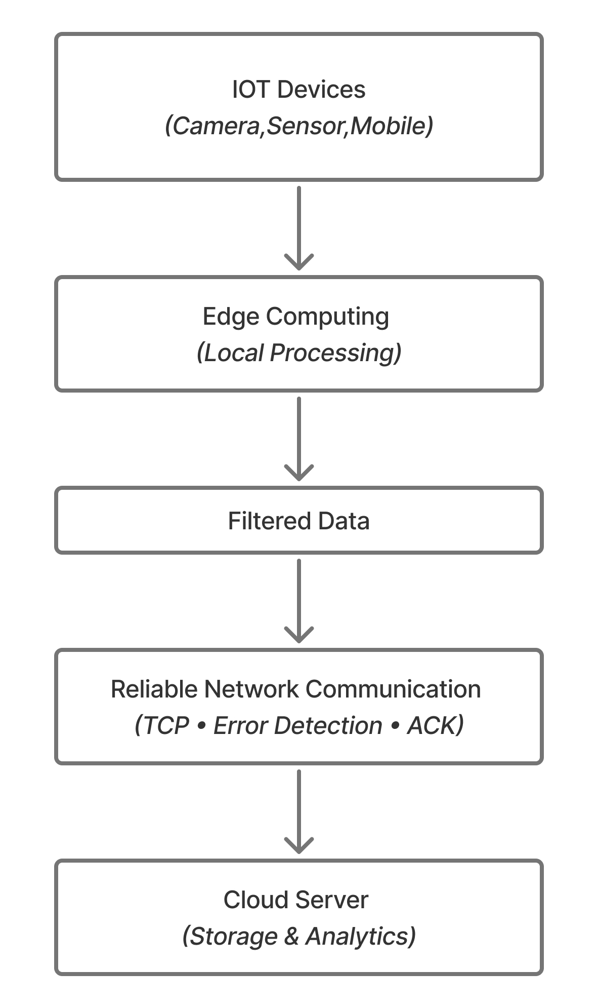
Reliable Data Transmission
Reliable Data Transmission ensures that data is delivered:
Correctly
Completely
In the correct order
Without duplication
Techniques Used
TCP (Transmission Control Protocol)
ACK (Acknowledgement)
CRC (Cyclic Redundancy Check)
ARQ (Automatic Repeat reQuest)
Flow Control
Congestion Control

Slide 5
CONCLUSION
Edge Computing reduces latency by processing data near the source.
Reliable Data Transmission ensures accurate, secure, and complete communication.
Together, they improve the speed, reliability, and efficiency of modern computer networks.
Application: Smart Cities, Healthcare Monitoring, Industrial IoT, Autonomous Vehicles, 5G Networks

Slide 6


